Slide 1
UI DESIGN AND IMPLEMENTATION
ROAD SIGN AND ROAD STATE MOBILE NOTIFICATION APP
CAM WE-GO

Slide 2
01
SITE MAP

Slide 3
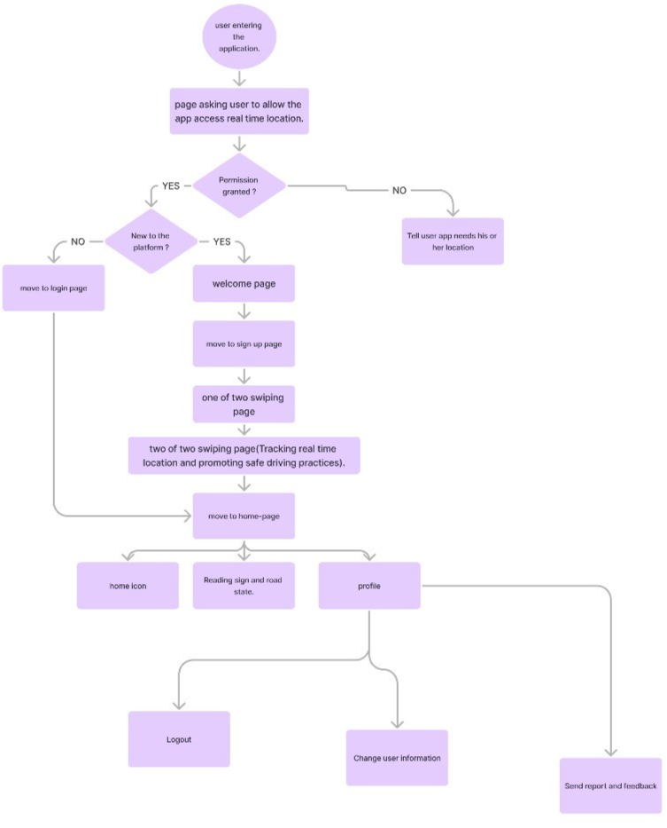
Site Map

Slide 4
Site Map

Slide 5
DESIGN SYSTEM
02

Slide 6
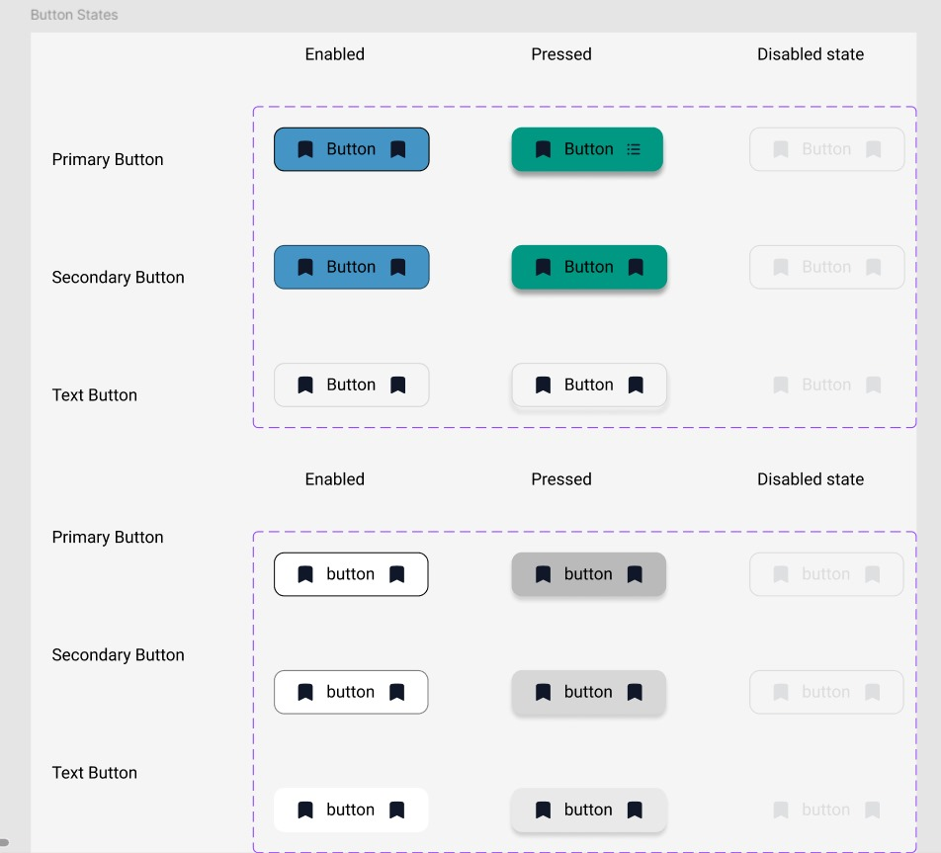
Buttons

Slide 7
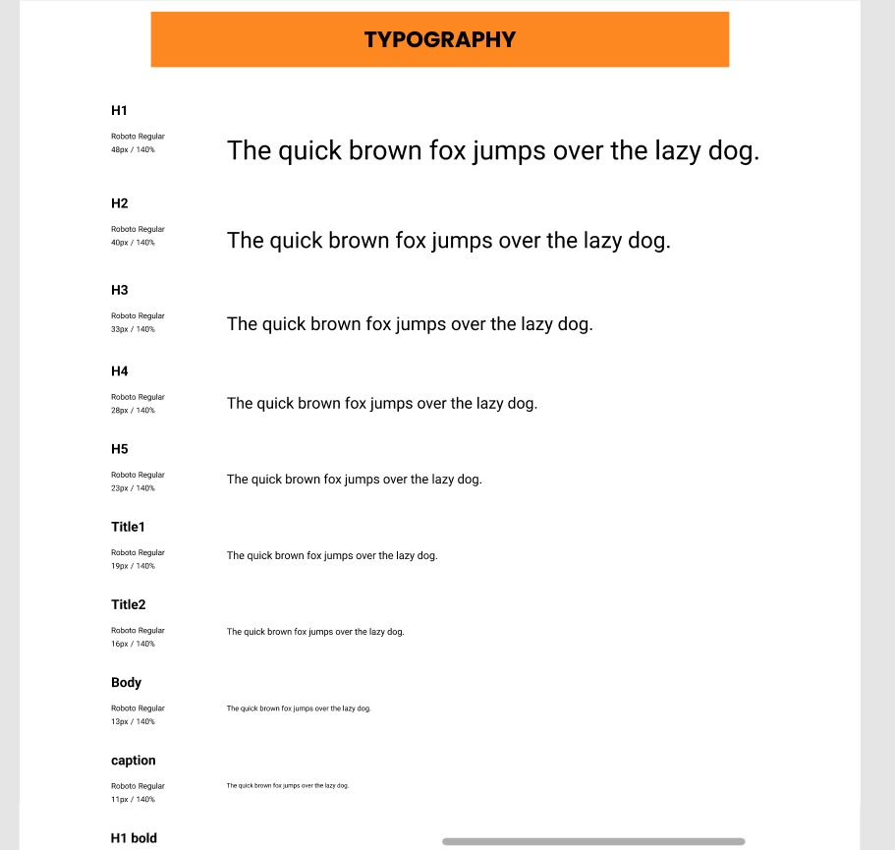
Typography

Slide 8
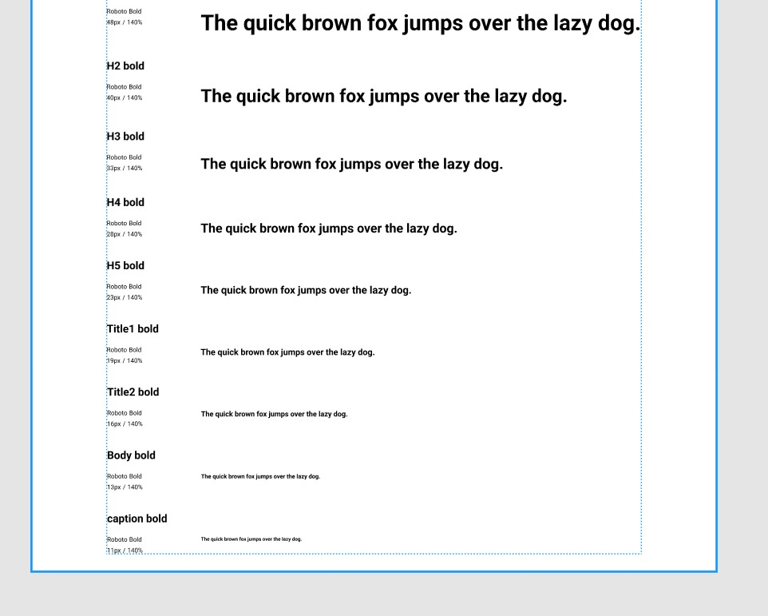
Typography

Slide 9
Colors
Primary
Other
Secondary

Slide 10
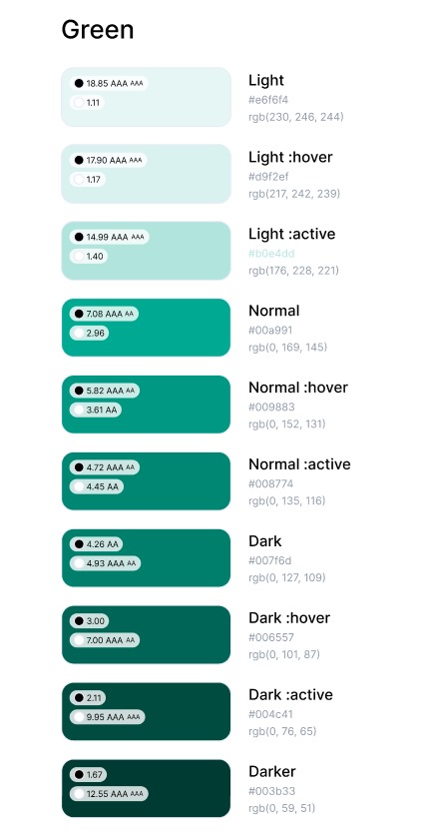
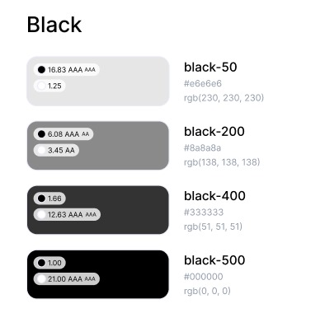
Colors

Slide 11
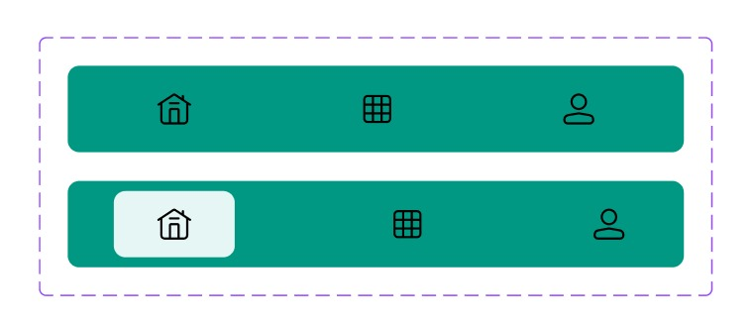
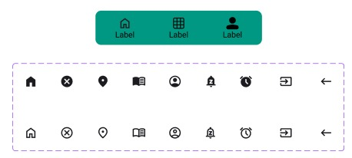
Icons

Slide 12
03
USER INTERFACE

Slide 13
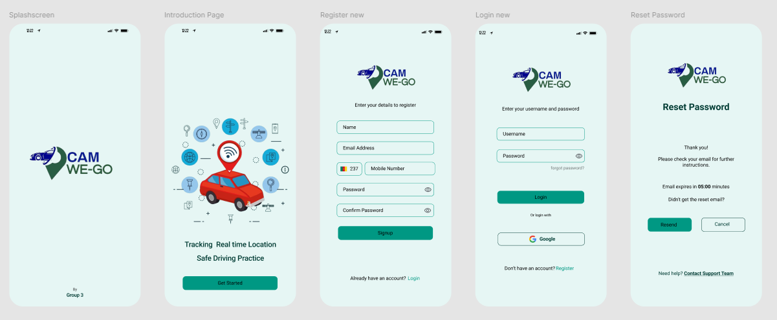
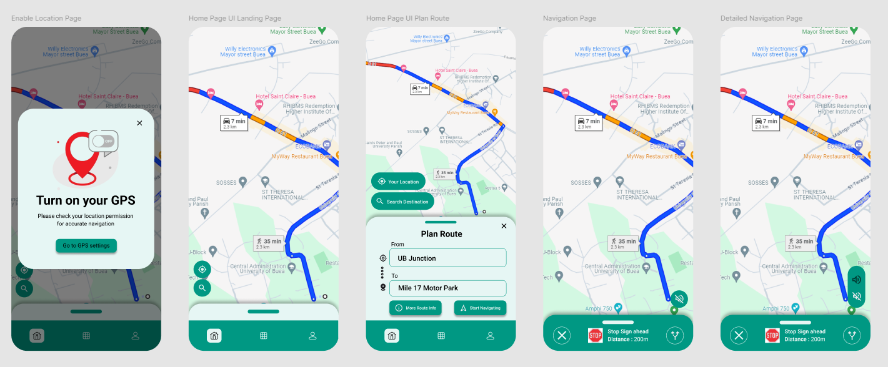
UI

Slide 14
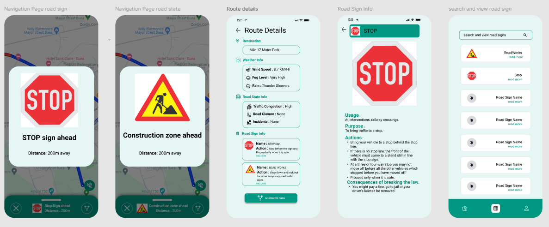
UI

Slide 15
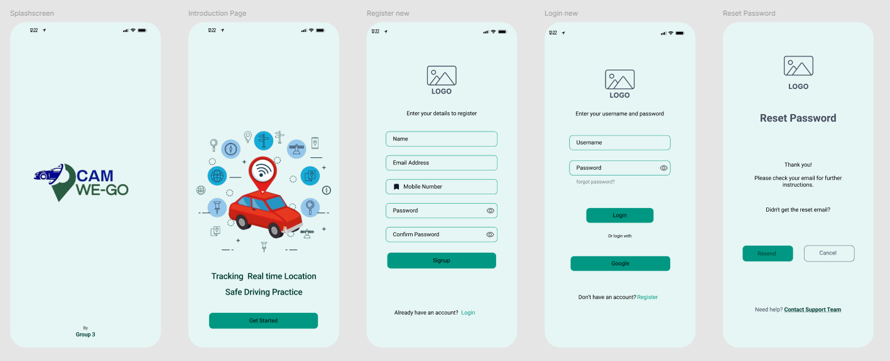
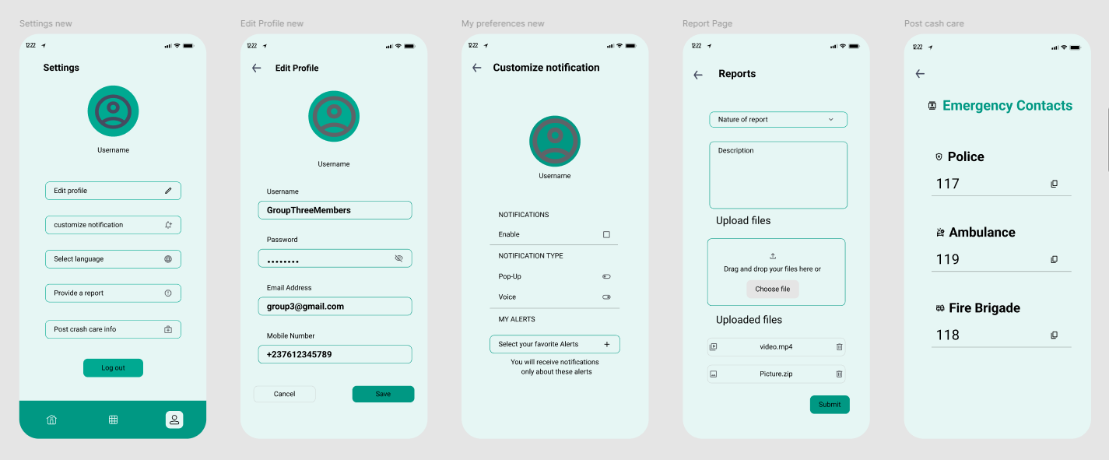
UI

Slide 16
UI

Slide 17
04
ADMINISTRATOR DASHBOARD

Slide 18
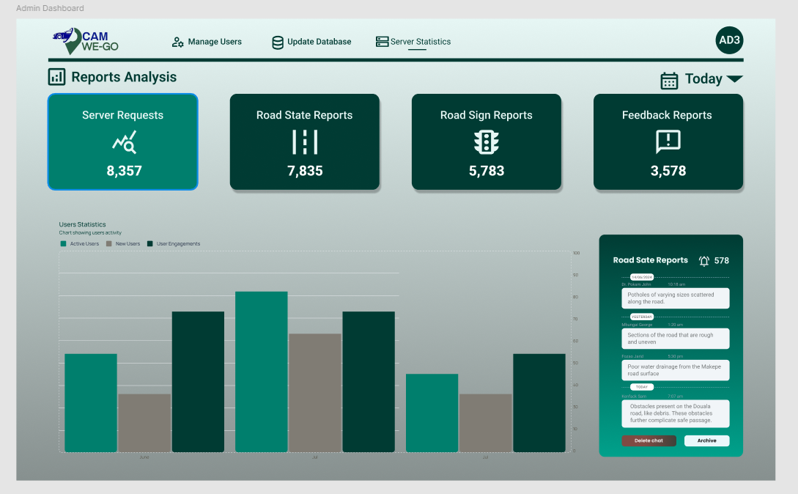
Admin

Slide 19
THANK YOU!
PRESENTED BY GROUP 3

